Slide 1

How Electricity Fuels Pakistan’s Economic Growth: A Time Series Analysis
By: Ayesha Ashraf and Muhammad Abdullah

Slide 2
Introduction
Electricity is a fundamental driver of economic growth, powering industries, households, and innovation.
For Pakistan, electricity consumption reflects industrialization, infrastructure expansion, and development progress.
The electricity–growth nexus is debated: does electricity drive growth, or does growth drive electricity demand?
Our study uses time‑series data (2000–2024) within a Cobb‑Douglas framework to examine the relationship.
Our findings contribute to energy policy and sustainable development, guiding investment and planning decisions.

Slide 3
Research question and hypothesis
Research Question:
Does electricity consumption drive economic growth, or does economic growth drive electricity consumption?
Hypotheses:
H0: Electricity consumption positively affects GDP growth.
H1: GDP growth positively affects electricity consumption

Slide 4
Variables and conceptual framework
GDP_Grwth​(t)=β0​+β1​ln(Electricity_t)+β2​(Inflationt​)+β3​(Unemploymentt)​+εt
Gdp_grwth(t)= Annual GDP growth rate
Ln(Electricityt) = log of electricity consumption
Inflation = log of electricity consumption
Unemployment = unemployment rate
εt = Random error term
t = in years

Slide 5
Original Regression Equation
 | (1)
VARIABLES | GDP-Grwth
Ln-electricity | 0.0407
 | (0.389)
inflation | -0.181
 | (0.295)
unemployment | 0.00459
 | (0.185)
Constant | 2.945
 | (3.018)
Observations | 50
R-squared | 0.006

Slide 6
Data and methodology
Data: Annual time-series data for Pakistan (GDP growth, electricity consumption, inflation, unemployment).
Stationarity: ADF unit root tests; non-stationary variables converted to first differences.
Correlation Analysis: Identify relationships and check multicollinearity.
Regression Model: OLS model estimating impact of electricity consumption on GDP growth.
Diagnostics: Tests for heteroskedasticity, residual normality, and multicollinearity

Slide 7
Descriptive Statistics

Slide 8
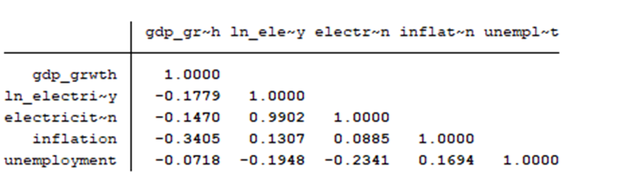
Correlation Analysis

Slide 9
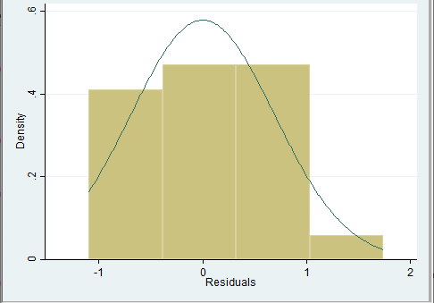
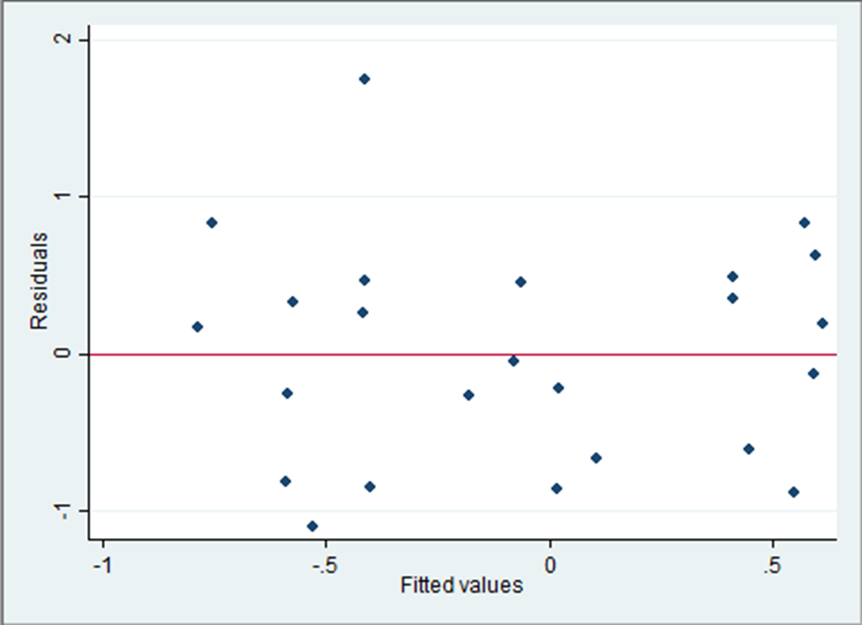
Diagnostic Tests

Slide 10
Results and Interpretations
 | (1) | (2) | (3) | (4) | (5)
VARIABLES | OLS baseline | OLS Robust | Newey-West (lag2) | Prais-Winsten | First-difference (robust)
ln_electricity | -0.3653 | -0.3653 | -0.3653 | 0.4083
 | (0.5247) | (0.4732) | (0.5122) | (0.4099)
inflation | -0.6920 | -0.6920 | -0.6920* | -0.9040**
 | (0.4611) | (0.4382) | (0.3759) | (0.3737)
unemployment | -0.0544 | -0.0544 | -0.0544 | -0.0680
 | (0.2433) | (0.2062) | (0.1703) | (0.2035)
D_ln_elec |  |  |  |  | 0.6596**
 |  |  |  |  | (0.3139)
D.inflation |  |  |  |  | -1.0677***
 |  |  |  |  | (0.3729)
D.unemployment |  |  |  |  | -0.0106
 |  |  |  |  | (0.1722)
Constant | 7.1566 | 7.1566* | 7.1566* | 2.0277 | -0.0733
 | (4.2049) | (3.6588) | (3.8413) | (3.2390) | (0.1520)
Observations | 25 | 25 | 25 | 24 | 24
R-squared | 0.136 | 0.136 |  | 0.260 | 0.328
Standard errors in parentheses
*** p<0.01, ** p<0.05, * p<0.1

Slide 11
1. Inflation becomes significant in every corrected model
OLS: insignificant
Newey-West: significant
Prais-Winsten: significant
First-difference: strongly significant
main variable of interest strengthens, both economically and statistically.
2. The effect of inflation becomes stronger
From –0.69 → –0.90 → –1.07.
Suggests OLS understated the true effect due to serial correlation or nonstationarity.
3. Model fit improves
R² rises from 0.136 → 0.260 → 0.328.
Implies your corrected models explain substantially more variation.
4. No major changes for ln_electricity or unemployment
Both remain insignificant and inconsistent.

Slide 12
Conclusion and Policy Implications
Conclusion:
Moderate GDP growth, stable inflation, rising unemployment.
Electricity consumption upward trend, but regression shows weak statistical link to GDP.
Model suggests omitted variables may play a larger role.
Policy Implications:
Invest in Electricity Infrastructure — expand generation, improve grid reliability, rural electrification.
Integrate Energy Policy with Growth Strategy — align with industrial and digital development.
Monitor Inflation & Labor Market — maintain stability, address structural unemployment.
Improve Data & Model Specification — include capital formation, trade openness, energy prices.

